Slide 1
CAR# 173917782 Finding
Q1 to Q2: Balina
Q3 to Q4: Jasper
Q5 to Q6: Thomas
Q7: Anne

Slide 2
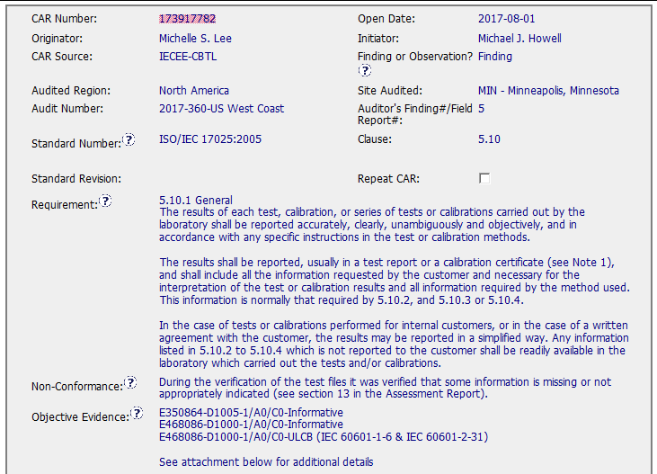
CAR# 173917782 - Balina Ling

Slide 3
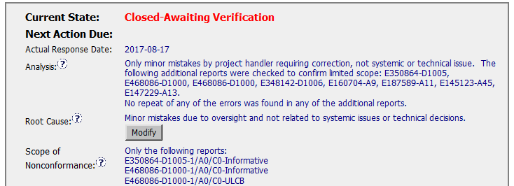
CAR# 173917782 - Balina Ling
Q2: Explain how/If the analysis supports the root cause statement.
It mentioned in analysis that only minor mistakes by project handler, but it can’t reflect the mistake was due to oversight or project handler didn’t know the requirement though it was identified as oversight in root cause.
And in analysis area, stakeholders were not identified.
Q1: Explain how/If the nonconformity is fully addressed in the analysis
From the analysis, it not mentioned what the nonconformity is.
Notes:
Highlight key points for below criteria:
•Explain how/If the nonconformity is fully addressed in the analysis
•Explain how/If the analysis supports the root cause statement
•Explain how/If the analysis supports the Scope of Nonconformance statement

Slide 4
CAR# 173917782 – Jasper Wu
Q3: Explain how/If the analysis supports the Scope of Nonconformance statement
It mentioned in analysis that additional reports were checked and no repeat error. But not sure the additional reports that were checked is from the same project handler or from the whole team. It should randomly check the projects of whole team.
Notes:
Highlight key points for below criteria:
•Explain how/If the nonconformity is fully addressed in the analysis
•Explain how/If the analysis supports the root cause statement
•Explain how/If the analysis supports the Scope of Nonconformance statement

Slide 5
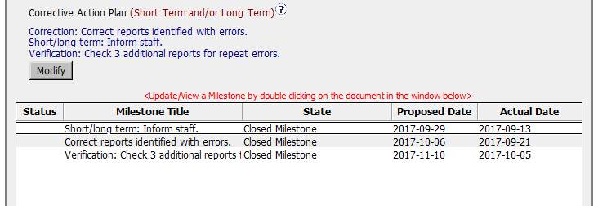
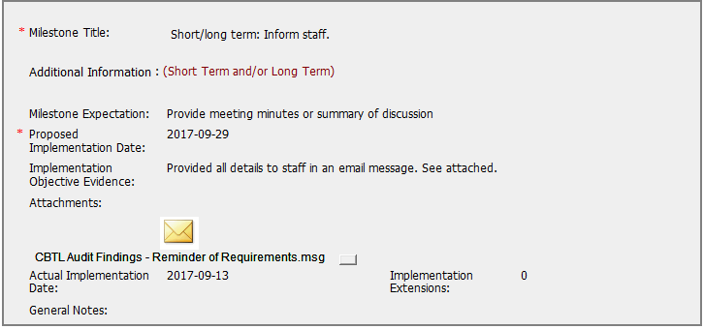
CAR# 173917782 – Jasper Wu
Q4: Explain why/If the Corrective Action Plan will prevent the recurrence of the nonconformity
Root cause mentioned it is project handler’s oversight. The short term “Inform staff” maybe will prevent the recurrence of the nonconformity.
Notes:
Highlight key points for below criteria:
•Explain how/If the nonconformity is fully addressed in the analysis
•Explain how/If the analysis supports the root cause statement
•Explain how/If the analysis supports the Scope of Nonconformance statement

Slide 6
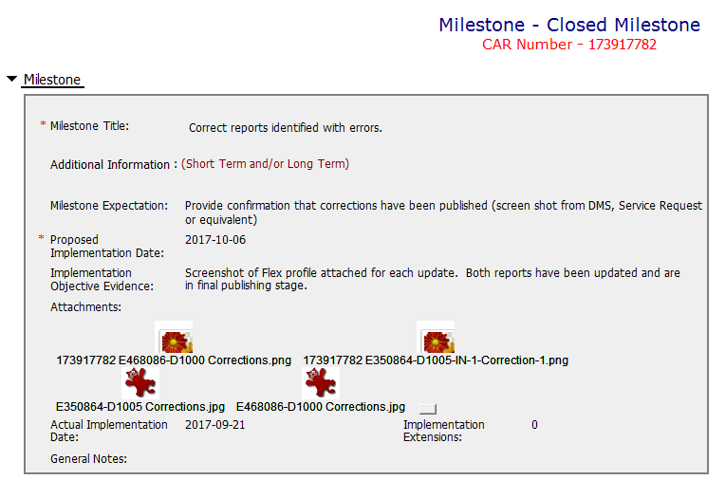
CAR# 173917782 - Thomas Kestner
Q5: Explain how/If the containment milestone “stopped the bleeding”
Since after deeper analysis, the nonconformity scope is just limited to the 3 projects, so corrected these 3 reports can stop the bleeding.
Notes:
Highlight key points for below criteria:
•Explain how/If the nonconformity is fully addressed in the analysis
•Explain how/If the analysis supports the root cause statement
•Explain how/If the analysis supports the Scope of Nonconformance statement

Slide 7
CAR# 173917782 - Thomas Kestner
Q6: Confirm that/If all corrective action milestones are aligned to each item of the corrective action plan.
All corrective action milestones are aligned to each item of the corrective action plan. But sequence changed, containment action “correction” should be put in front of short/long term “Inform staff”.
Notes:
Highlight key points for below criteria:
•Explain how/If the nonconformity is fully addressed in the analysis
•Explain how/If the analysis supports the root cause statement
•Explain how/If the analysis supports the Scope of Nonconformance statement

Slide 8
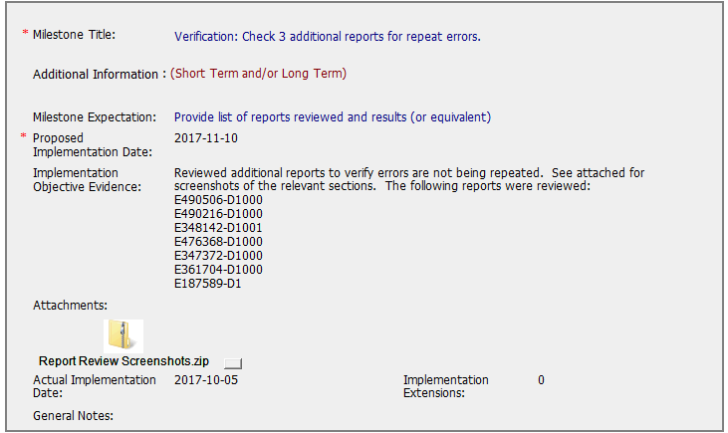
CAR# 173917782 - Anne Deng
Q7: Explain how/If the verification milestone confirmed the effective implementation of the corrective action plan
In the verification, additional reports have been checked to verify same error not be repeated, so the verification milestone confirmed the effective implementation of the corrective action plan.
Notes:
Highlight key points for below criteria:
•Explain how/If the nonconformity is fully addressed in the analysis
•Explain how/If the analysis supports the root cause statement
•Explain how/If the analysis supports the Scope of Nonconformance statement

Slide 9
CAR# 173917782 – CAR Review Criteria Check
CAR Review Criteria | Fully | Partially | Not at all | N/A
•Is the nonconformity fully addressed in the analysis? |  |  | √
•Does the analysis support the root cause statement? |  | √
•Does the analysis support the Scope of Nonconformance statement |  | √
•Will the Corrective Action Plan prevent recurrence of the nonconformity? |  | √
•Did the containment milestone “stop the bleeding”? | √
•Are corrective action milestones aligned to each item of the corrective action plan? |  | √
•Did the verification milestone confirm the effective implementation of the corrective action plan? | √

Slide 10
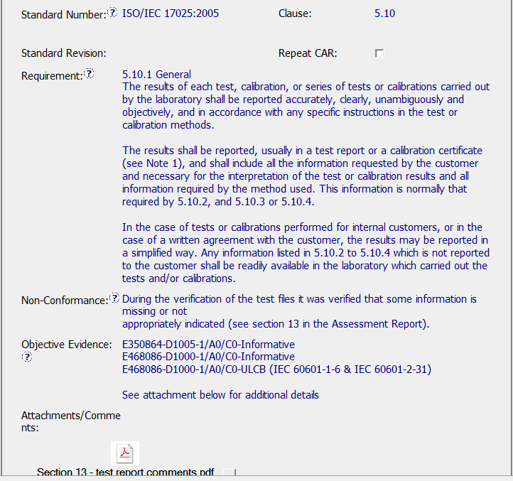
Finding CAR # 173917782

Slide 11
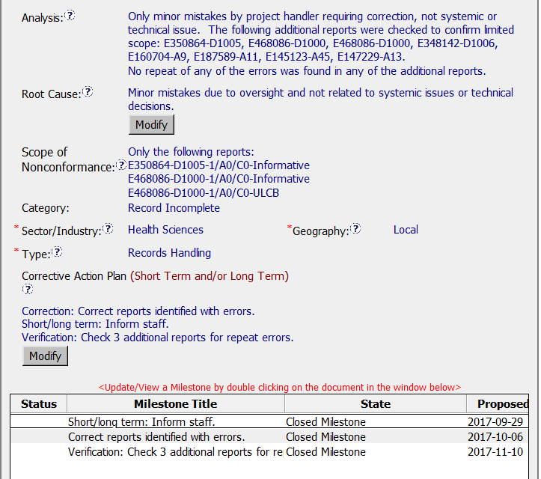
Finding CAR # 173917782

Slide 12
Finding CAR # 173917782
Explain how/If the nonconformity is fully addressed in the analysis
(PM) The analysis has not identified stakeholders who participated in the analysis to ensure that all aspects are considered. The owner sampled 8 additional projects to make the determination that that the mistakes were ‘not systemic or technical issue’. However, with 3 projects identified in the CAR that indicated errors, that’s approximately 27% error rate. Also, the analysis did not mention how the 8 projects were selected; same individual, team, time frame, etc. So, it’s not clear how a 'not systemic' determination was made. In addition, the non-technical aspect was not clarified. As a result, further analysis was not pursued.
Explain how/If the analysis supports the root cause statement
(PM) Based on the concerns noted about the analysis, it's not clear if the root cause statement can be supported.

Slide 13
Finding CAR # 173917782 cont.
Explain how/If the analysis supports the Scope of Nonconformance statement
(KB) – Yes, good statement: “The following additional reports were checked to confirm limited scope” It would be even better if they would have said why those reports were checked (e.g., “last 12 months of records”)
Explain why/If the Corrective Action Plan will prevent the recurrence of the nonconformity
(KB) – Not clear since root was not discovered. Why were these errors made? If it was only ignorance, then “inform staff” would be sufficient . However, there were nice examples in the email for the short/long term actions taken.

Slide 14
Finding CAR # 173917782 cont.
Explain how/If the containment milestone “stopped the bleeding”
(NTG) – Containment fixed the immediate known errors cited in the objective evidence.
Confirm that/If all corrective action milestones are aligned to each item of the corrective action plan
(NTG) - Milestones were directly aligned with the corrective action items.

Slide 15
Finding CAR # 173917782 cont.
Explain how/If the verification milestone confirmed the effective implementation of the corrective action plan
(CR) The verification milestone did not confirm the effective implementation of the corrective action plan
Although report numbers were provided, there was no additional information/evidence pertaining to the results of the review; the CAR champion should have asked for a clear statement of results for the verification. Also, there was no correlation between the listed projects and what was attached.
OFI - the verification specified checking 3 additional reports however 13 projects were included in the screenshot as being verified and only 7 projects were listed in the Milestones Implementation Evidence.

